Slide 1
k-NN Process
Decide on your similarity or distance metric.
Split the original labeled dataset into training and test data.
Pick an evaluation metric.
Run k-NN a few times, changing k and checking the evaluation measure.
Optimize k by picking the one with the best evaluation measure.
Once you’ve chosen k, use the same training set and now create a new test set with the people’s ages and incomes that you have no labels for, and want to predict

Slide 2
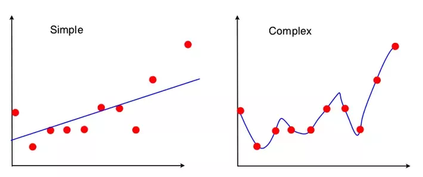
Bias vs Variance
Bias refers to the error due faulty assumptions in the learning algorithm. Bias results in under-fitting the data. A high bias means our learning algorithm is missing important trends amongst the features.
Variance refers to the error due to an overly-complex that tries to fit the training data as closely as possible. In high variance cases the model’s predicted values are extremely close to the actual values from the training set. The learning algorithm copies the training data’s trends and this results in loss of generalization capabilities. High Variance gives rise to over-fitting
The below shows a case of high variance/low bias on the right and high bias/low variance on the left.

Slide 3
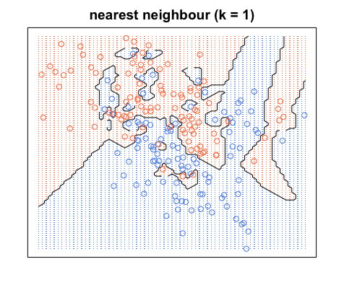
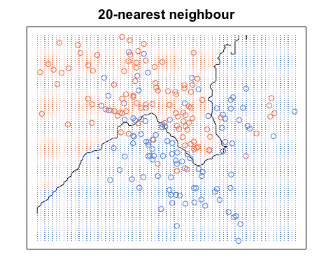
Decision Boundary
For every point in this space, we can determine its label using NN rule. This gives rise to a decision boundary that partitions the space into different regions.

Slide 4
How to choose an optimal K?
A small value for K provides the most flexible fit, which will have low bias but high variance.
Larger values of K will have smoother decision boundaries which means lower variance but increased bias.

Slide 5
Similarity or Distance Metrics
It depends on the problem
Must be decided with great care
In our example, we can choose Euclidean distance as distance metrics
  Reperesenting salaries in Dollars (34,40000,715) VS representing salaries in thousand of dollars (34,40,715)
  THE WAY YOU SCALE YOUR VARIABLES HAS A GREAT EFFECT ON THE OUTPUT

Slide 6

Closeness Metrics
Euclidean Distance
  Good for attributes that are real valued and can be plotted on x-dimensional space
Cosine similarity
  Can be used between two real value vectors
  Interpretation: -1 (completely opposite), 1 (exactly the same), 0 (independent)

Slide 7
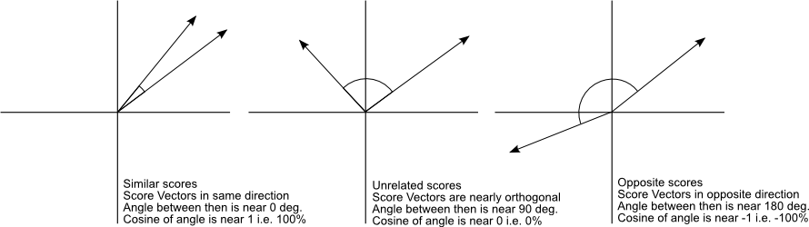
Cosine Similarity (Example)

Slide 8
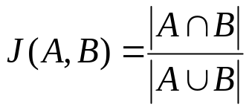

Closeness Metrics
Jaccard Distance or Similarity
  Calculate distance between set of objects
Mahalanobis Distance
  More useful than Euclidean distance as it is scale-invariant
  Where is S is covariance matrics

Slide 9
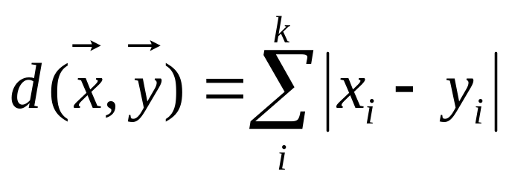
Closeness Metrics
Hamming distance
  Can be used to find distance between two strings or two sequences
  The distance between HOT and NOT is 1, while the distance between HOT and NET is 2
Manhattan
  Used to find distance between real valued vectors

Slide 10
Training and Test Sets
Machine learning algorithm
  Training phase: create a model and train it
  Testing phase: test the accuracy of the model
What is the training data for our example?
What is the testing data for our example?

Slide 11
Choosing an Evaluation Metrics
One possibility is accuracy: which is the ratio of number of correct labels to the total number of labels
Misclassification rate = 1 – accuracy
How to determine value of k?
  The one which gives minimum misclassification rate

Slide 12
When K-NN can be used?
Similarity of objects can be measured
Training data has been classified in two or more classes
The observed features and labels have some association

Slide 13
QUESTIONS

